Slide 1

MEDICON 2016, XIV MEDITERRANEAN CONFERENCE ON MEDICAL AND BIOLOGICAL ENGINEERING AND COMPUTING - PAPHOS, CYPRUS, March 31st – April 2nd
The influence of noise in dynamic PET direct reconstruction
M. Scipioni^{1,2}, M. F. Santarelli^{3,2}, V. Positano² and L. Landini^{1,2}
1 Department of Information Engineering, University of Pisa, Pisa, PI, Italy
2 Fondazione G. Monasterio,CNR-Regione Toscana, Pisa, PI, Italy
3 Institute of Clinical Physiology, CNR, Pisa, PI, Italy
Dept. of Information Engineering, University of Pisa, Pisa, Italy
Notes:
Good morning everybody! I thank the chairs for the kind introduction!

Slide 2


Aim
Direct reconstruction methods are one of the most up-to-date topic in PET research and several different algorithms have been presented in the last few years.
However, no studies have been performed so far about the evaluation of the performance of this new class of direct reconstruction algorithms when noisy data are considered. In fact, it is well known that the presence of noise sources compromises the estimation of the emission density when ML reconstruction algorithms are used.
In the present work we study the behavior of a particular direct reconstruction algorithm, starting from dynamic PET data with different noise degrees. Such evaluation is performed by simulating realistic PET measured data, adding the effects of different noise sources and analyzing them with new approach.
Saturday, April 2nd 2016
MEDICON 2016 - Paphos, Cyprus
Dept. of Information Engineering,
University of Pisa, Pisa, Italy
Michele Scipioni
The influence of noise in dynamic PET direct reconstruction
Notes:
Today I am going to talk about direct kinetic modeling and how good this kind of practice could be for the creation of parametric maps from dynamic PET studies. This new class of algorithms has been one of the trending topic of the last few years PET methodological research but as for now, no studies have been performed about the evaluation of the performances of this methods when very noisy data are considered.

Slide 3
Saturday, April 2nd 2016
Background
MEDICON 2016 - Paphos, Cyprus
Dept. of Information Engineering,
University of Pisa, Pisa, Italy
Michele Scipioni
The influence of noise in dynamic PET direct reconstruction
Notes:
Before to go deeper into the subject, however, I want to take a step back and to present you a bit of the background of the matter we are going to discuss.

Slide 4
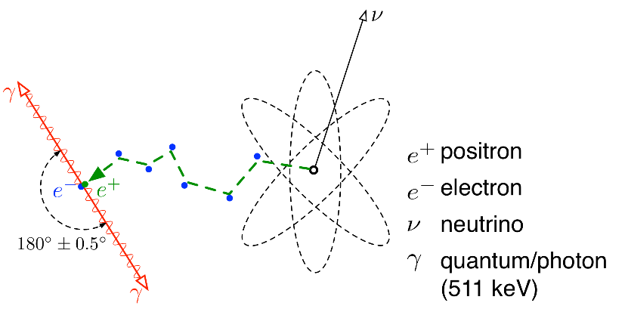
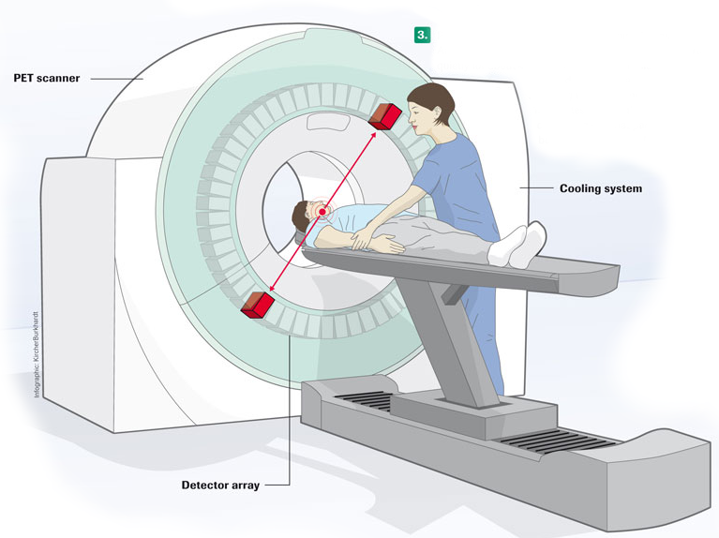
Positron Emission Tomography (PET)
Saturday, April 2nd 2016
MEDICON 2016 - Paphos, Cyprus
Dept. of Information Engineering,
University of Pisa, Pisa, Italy
Michele Scipioni
The influence of noise in dynamic PET direct reconstruction
Notes:
I won’t go into details but we should recall that positron emission tomography is a tomographic imaging technique based on the detection of coincidence photons, produced as a result of the annihilation of an electron and a positron, emitted by the radiotracer injected into the patient’s body.

Slide 5
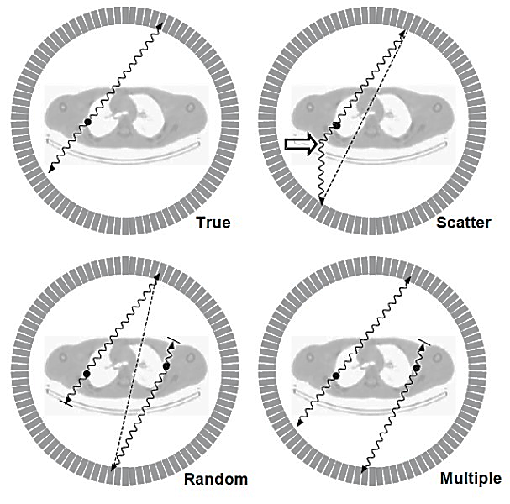
Noise sources
Noise can be categorized as structured or unstructured noise.
Saturday, April 2nd 2016
Random statistical variations in the counting rate (Poisson counting noise), modulated by applied correction and the chosen reconstruction algorithm.
MEDICON 2016 - Paphos, Cyprus
Dept. of Information Engineering,
University of Pisa, Pisa, Italy
Michele Scipioni
The influence of noise in dynamic PET direct reconstruction
Notes:
This kind of measurement is usually affected by a lot of noise sources, that we can categorize into 2 classes: structured and non-structured noise. Structured artifacts are non-random variations caused by disturbing patterns, patient movement or suboptimal performance of the detection system. Here we are focused on unstructured noise, such as erroneous counts due to scattering events, random or multiple coincidences.

Slide 6
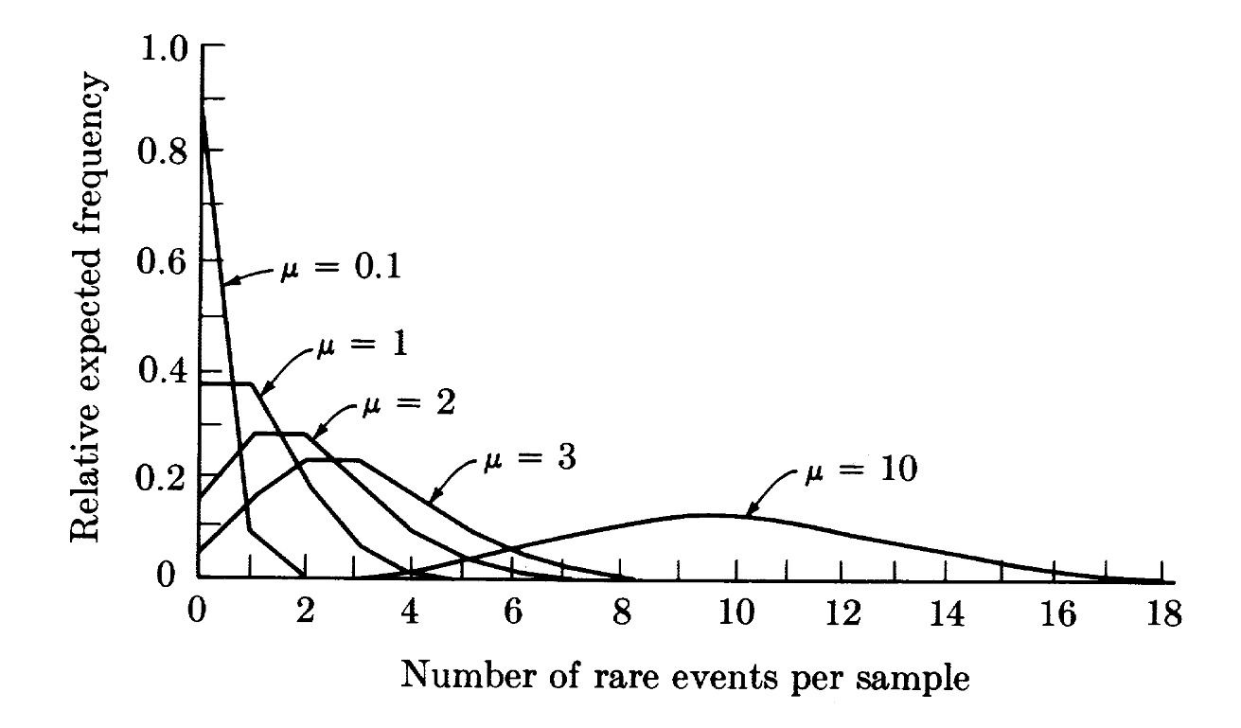
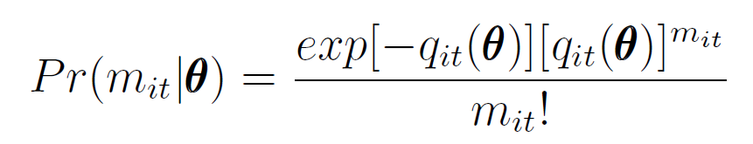
Statistical distribution of noise
The random process of photon detection generates a variation in the counts that can be described with a Poisson distribution. This is actually the main cause of noise!
UNCORRECTED RAW DATA
nonstationary noise but uncorrelated and with a known Poisson nature
CORRECTION PREPROCESSING
prior to reconstruction these changes alter the distribution of projection’s noise
RECONSTRUCTION STEP
reconstruction step adds spatial correlation to the noise in the images
PET IMAGES
The noise is characterized by un unknown statistical distribution and all we can do is to make assumptions to model it
Saturday, April 2nd 2016
MEDICON 2016 - Paphos, Cyprus
Dept. of Information Engineering,
University of Pisa, Pisa, Italy
Michele Scipioni
The influence of noise in dynamic PET direct reconstruction
Notes:
It is important to recall how the random process of photons’ detection generates a variation in the counts that can be described as a Poisson distribution. In fact, if we look at the formula, we can see how If at a certain instance 100 photons are counted, a repetition of the measurement will likely give a new value that differs from the first one within 10%. This is actually the main cause of noise! In addition to this, the Poisson distribution is typical of the uncorrected raw data: the operations of correction and reconstruction change this statistical property, amplifying the noise and adding spatial correlation to it, giving us final PET images characterized by unknown statistical distribution about which all we can make is an assumption about its nature.

Slide 7
Saturday, April 2nd 2016
Dynamic functional imaging
MEDICON 2016 - Paphos, Cyprus
Dept. of Information Engineering,
University of Pisa, Pisa, Italy
Michele Scipioni
The influence of noise in dynamic PET direct reconstruction
Notes:
This problem cannot help but be even greater in dynamic studies, when we have to deal with several different sinograms and then images

Slide 8
Why?
Dynamic studies are performed to quantify tissue-specific biochemical properties. When acquiring a dynamic PET scan, the activity of the PET tracer is measured at multiple time points, involving a sequence of acquisitions.
Saturday, April 2nd 2016
Monitor the tracer’s distribution in and metabolization by the tissues.
Estimate important metabolic parameters (blood flow, binding potentials, metabolic rates, …)
MEDICON 2016 - Paphos, Cyprus
Dept. of Information Engineering,
University of Pisa, Pisa, Italy
Michele Scipioni
The influence of noise in dynamic PET direct reconstruction
Notes:
Just as a reminder: dynamic studies are the essence of PET imaging, since they allow us to quantify tissue-specific biochemical properties, monitoring the tracer’s distribution and metabolization inside the patient’s body, and estimating biochemical parameters like blood flow, binding potentials, metabolic rates, and so on …

Slide 9
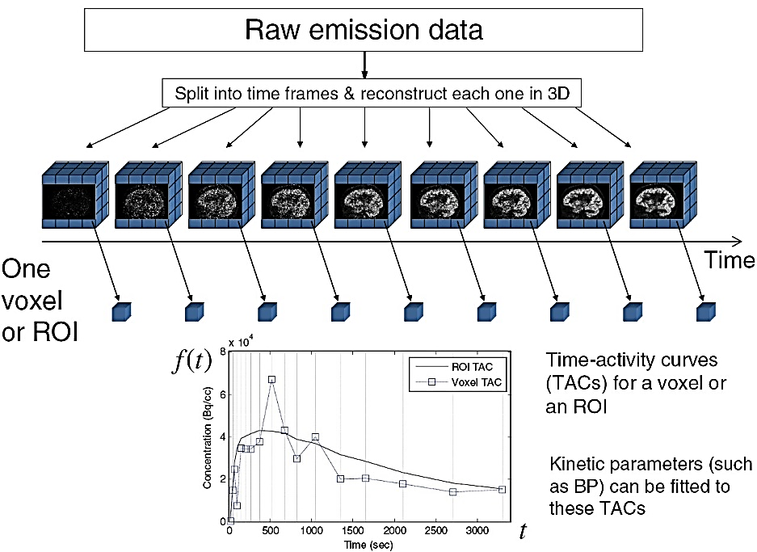

Conventional analysis of dynamic sequences
Saturday, April 2nd 2016
One voxel or ROI
MEDICON 2016 - Paphos, Cyprus
Dept. of Information Engineering,
University of Pisa, Pisa, Italy
Michele Scipioni
The influence of noise in dynamic PET direct reconstruction
Notes:
Usually, the methods to analyze those dynamic acquisitions can be described as follows: (1) starting from the raw data, we reconstruct each sinogram into an image that is a time frame of our series, then (2) we select a region of interest or a voxel, extract its time activity curve and fit a model to it so that we can extract kinetic parameters.

Slide 10
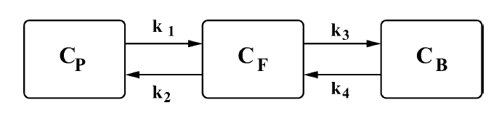
Compartmental model
Saturday, April 2nd 2016
Kinetic analysis in a voxel-by-voxel fashion provides parametric images that can be used to determine the spatial distribution and metabolitation of the specific tracer.
MEDICON 2016 - Paphos, Cyprus
Dept. of Information Engineering,
University of Pisa, Pisa, Italy
Michele Scipioni
The influence of noise in dynamic PET direct reconstruction
Notes:
One of the most complete models we can use is this one, a 2 compartment 2 tissue 4 constants kinetic model. The voxel-wise fitting of this model to our image data allow us to create parametric maps, like this:

Slide 11
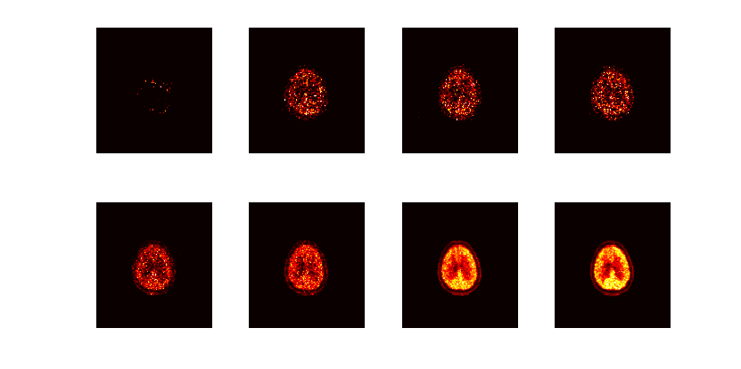
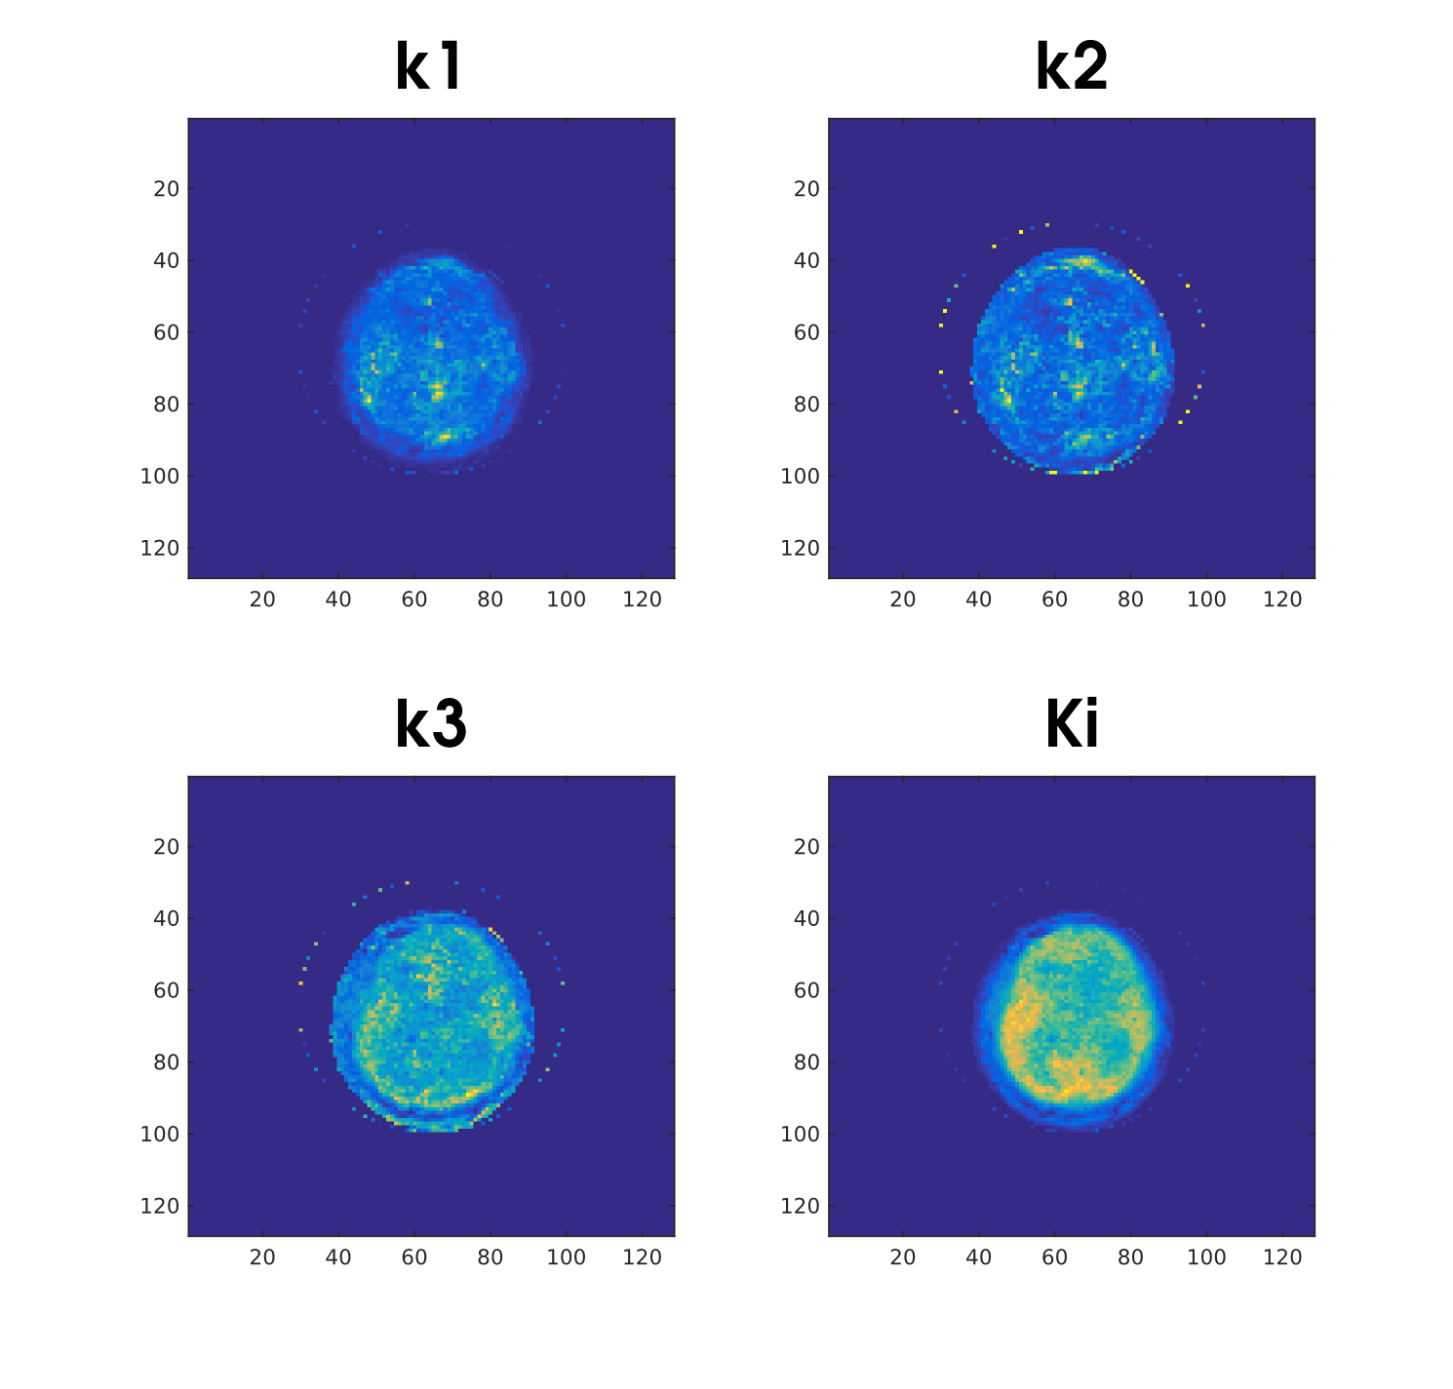
Compartmental model
…
…
…
…
Saturday, April 2nd 2016
…
…
…
…
MEDICON 2016 - Paphos, Cyprus
Dept. of Information Engineering,
University of Pisa, Pisa, Italy
Michele Scipioni
The influence of noise in dynamic PET direct reconstruction
Notes:
: this is an actual study we did on a clinical human dataset.

Slide 12
Saturday, April 2nd 2016
Direct parametric images estimation
MEDICON 2016 - Paphos, Cyprus
Dept. of Information Engineering,
University of Pisa, Pisa, Italy
Michele Scipioni
The influence of noise in dynamic PET direct reconstruction
Notes:
Why should we move from this to direct approach?

Slide 13
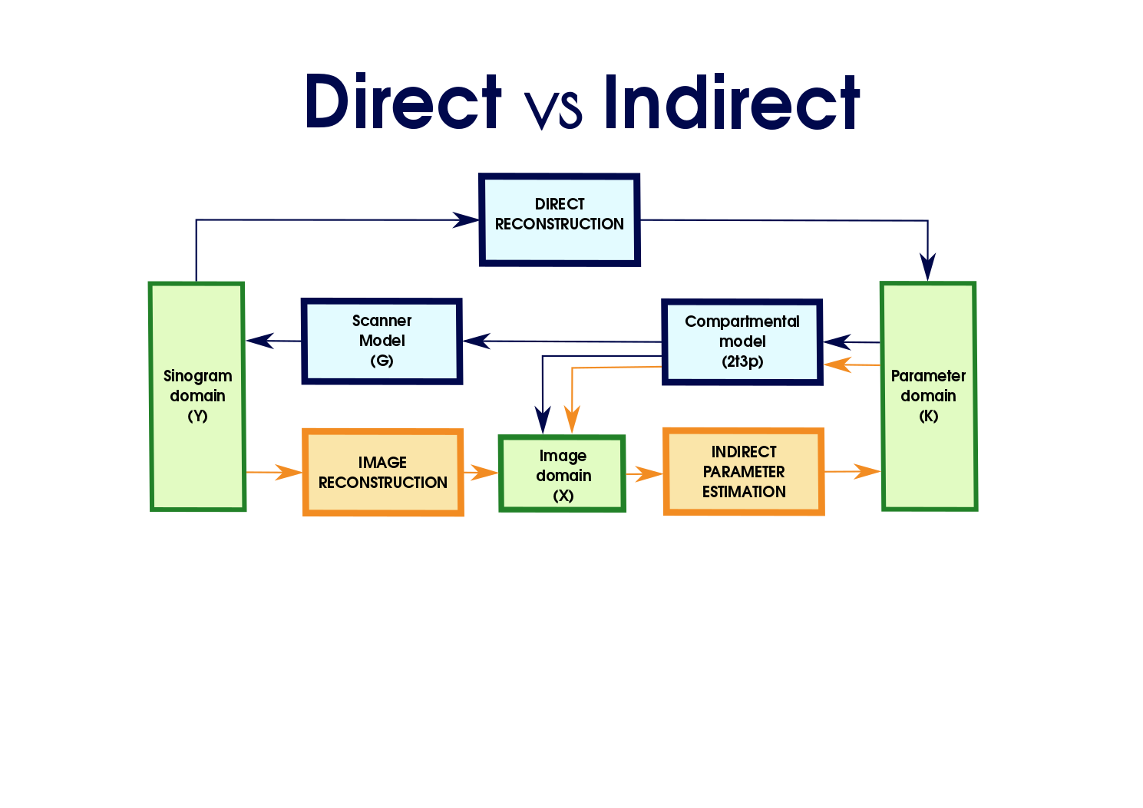
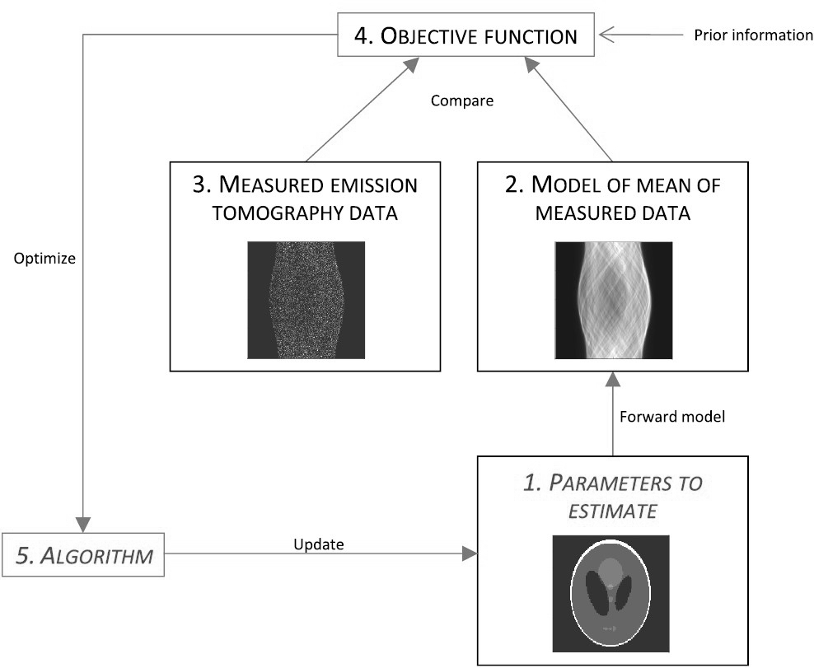
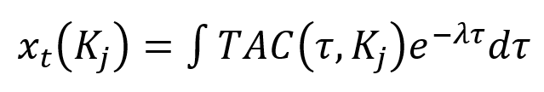
Novelty
Saturday, April 2nd 2016
MEDICON 2016 - Paphos, Cyprus
Dept. of Information Engineering,
University of Pisa, Pisa, Italy
Michele Scipioni
The influence of noise in dynamic PET direct reconstruction
Notes:
Let’s take a look at the following scheme. (1) the orange path shows the conventional indirect algorithm a just I presented to you: from a series of sinograms, we reconstruct a series of images, and then iteratively estimate the kinetic parameters. (2) on the contrary a direct approach aims to make direct use of the kinetic model to generate an expectation of the tracer distribution starting from an initial guess of the parameters associated to each voxel; forward-projecting the output of the model, we obtain the expectation of the measured raw data that is clearly different from the real one. Now the iterative procedure aims to update voxel-wise the parameter estimates in order to minimize this difference! The big deal in doing so is that we avoid the intermediate reconstruction step, avoiding the amplification of the noise and the addition of spatial correlation I was talking about just a few minutes ago.

Slide 14
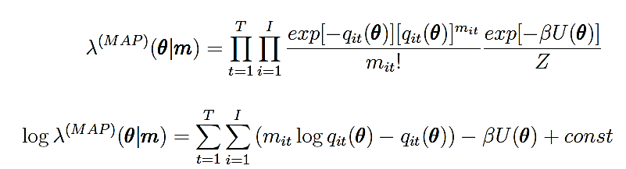
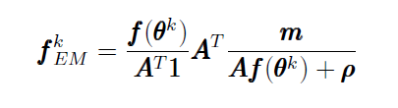
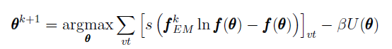
Optimization transfer
In order to estimate the updated parameter matrix K, we have to evaluate the following log-likelihood function:
Saturday, April 2nd 2016
measured sino
expected sino
penalization term
The proposed method finds the solution via an optimization transfer approach and dividing the update in 2 different steps:
MEDICON 2016 - Paphos, Cyprus
Frame-wise EM-like image update
Voxel-wise penalized likelihood fitting
Dept. of Information Engineering,
University of Pisa, Pisa, Italy
Michele Scipioni
The influence of noise in dynamic PET direct reconstruction
Notes:
We need to take a look at some math. In order to minimize that difference, we want to evaluate this likelihood function between the measured and the expected dynamic sinogram. This is actually computationally heavy, so we make use of a so called optimization transfer approach, dividing the likelihood maximization in two steps: the first one is actually a frame-wise EM-like image update, while the second is a voxel-wise penalized likelihood fitting. Iterating these two steps we can update the parameter estimate vector theta until we reach a convergence condition.

Slide 15
Saturday, April 2nd 2016
Simulation
MEDICON 2016 - Paphos, Cyprus
Dept. of Information Engineering,
University of Pisa, Pisa, Italy
Michele Scipioni
The influence of noise in dynamic PET direct reconstruction
Notes:
The present work aims to evaluate the performances of this method under different noise conditions. To do so we worked mainly in a simulation environment (even if we applied it to clinical data too, as I showed you in one of the previous slides).

Slide 16
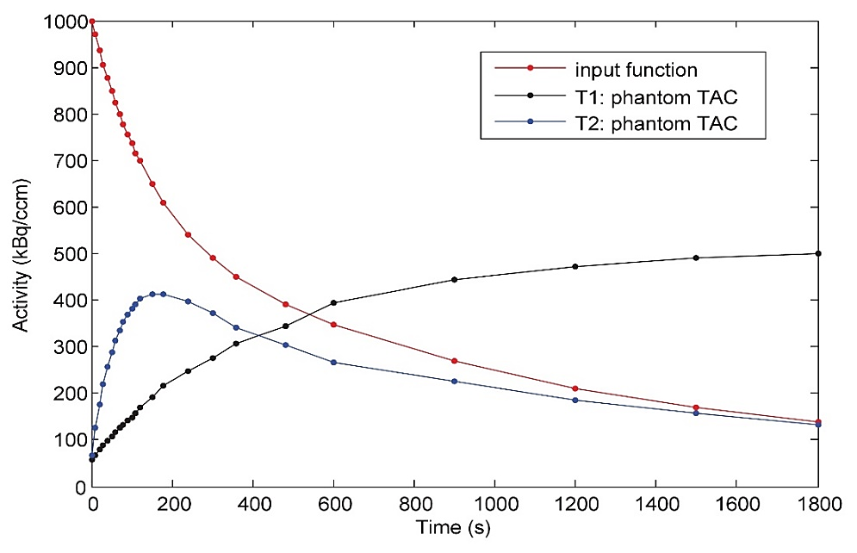
Simulated Dataset
Raw data are generated by projection of 2D radioactivity distribution functions into sinograms (true coincidences), adding random and scatter coincidences, and measurement noise. For each emission time frame, Poisson events are generated.
Saturday, April 2nd 2016
 | K1 | k2 | k3 | k4 | Ki | fv
T1 | 0,082 | 0,055 | 0,085 | 0,002 | 0,0497 | 0,05
T2 | 0,426 | 0,660 | 0,010 | 0,022 | 0,0064 | 0,03
Radius | 10 cm
Length | 15 cm
FOV | 70 cm
Image dimension | 128x128 px
Sino dimension | 186x360 px
MEDICON 2016 - Paphos, Cyprus
Dept. of Information Engineering,
University of Pisa, Pisa, Italy
Michele Scipioni
The influence of noise in dynamic PET direct reconstruction
Notes:
The simulation involved a very simple cylindrical homogeneous phantom at which we assigned two sets of kinetic constants, in order to simulate two tissue types. The figure shows in red the simulated blood input function and in black and blue the time activity curves produced by the compartmental model when we gave it as input these two set of constants.

Slide 17
MonteCarlo simulations
We performed 50 repetitions of a Monte Carlo simulations changing the level of noise added to the simulated data, for each one of the main sources.
Saturday, April 2nd 2016
Accidental Scattering (AC) were generated as Poisson events identically distributed in the sinogram, with a constant mean value;
Random counts (RS) in the sinogram was modelled as a Gaussian function having its maximum at the center of each projection, and extending to the tails, which are outside the source boundary;
Gaussian measurement noise values (GN) are the means of a Poisson events generator
 | Min | Max
AC | 0% | 30%
RS | 0% | 30%
GN | 2%
Mean value of each noise source as a % of max sinogram’s value
MEDICON 2016 - Paphos, Cyprus
Dept. of Information Engineering,
University of Pisa, Pisa, Italy
Michele Scipioni
The influence of noise in dynamic PET direct reconstruction
Notes:
To the clean sinogram time series we add several different levels of accidental scattering, random coincidence counts and obviously Gaussian measurement noise, simulating each condition 50 times in a Monte Carlo framework.

Slide 18
Saturday, April 2nd 2016
Results
MEDICON 2016 - Paphos, Cyprus
Dept. of Information Engineering,
University of Pisa, Pisa, Italy
Michele Scipioni
The influence of noise in dynamic PET direct reconstruction
Notes:
Moving quickly towards the results section, we are going to look at two very similar slides:

Slide 19
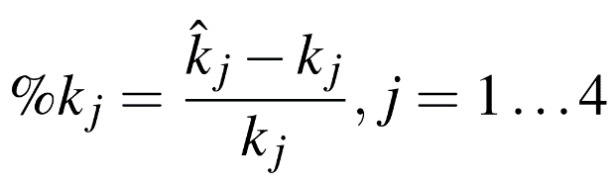
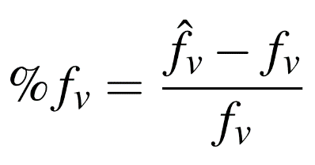
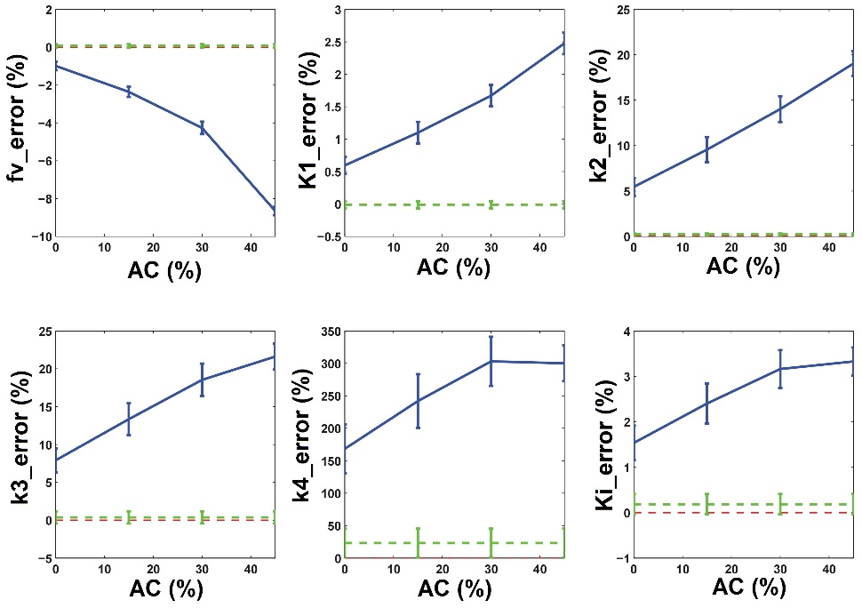
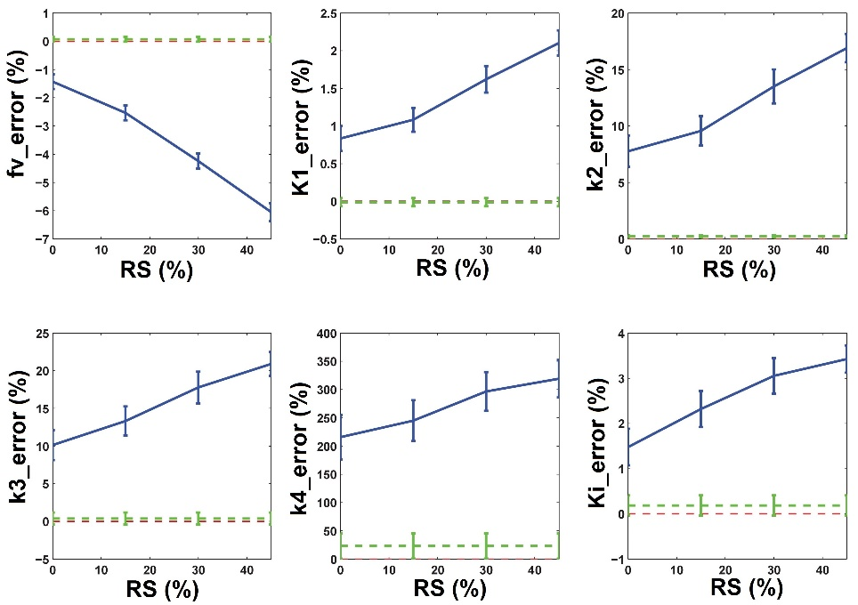
K1 | k2 | k3 | k4
0,082 | 0,055 | 0,085 | 0,002
Simulation 1 (T1)
Effect of accidental scattering and random counts on kinetic parameters estimation for both simulated phantoms.
Saturday, April 2nd 2016
MEDICON 2016 - Paphos, Cyprus
Accidental Scattering
Random Counts
Dept. of Information Engineering,
University of Pisa, Pisa, Italy
Michele Scipioni
The influence of noise in dynamic PET direct reconstruction
Notes:
this one shows the effect of scattering and random counts to the estimate of the kinetic constants for phantom T1. To make easier for you to follow, I reported the kinetic parameters of this simulation on the top of the slide. These are the figures of merit I used to quantify the error for each kinetic parameter and these are the results. Let me just guide you through them: red lines represent the reference of zero error, while the green lines are the estimation errors of the value of the parameters on data without noise. The fv parameter estimation gives always a negative percentage error; it means that the fractional volume of blood in the tissue is underestimated, also for low noise values. The percentage error of the k4 kinetic parameter seems to be very high; but it is worth to note that for tissue T1 the input k4 value is very low, so in reality the not-normalized error value is very low (less than 10^-4). As far as all the other parameters are concerned, the percentage errors are always less than 20%.

Slide 20
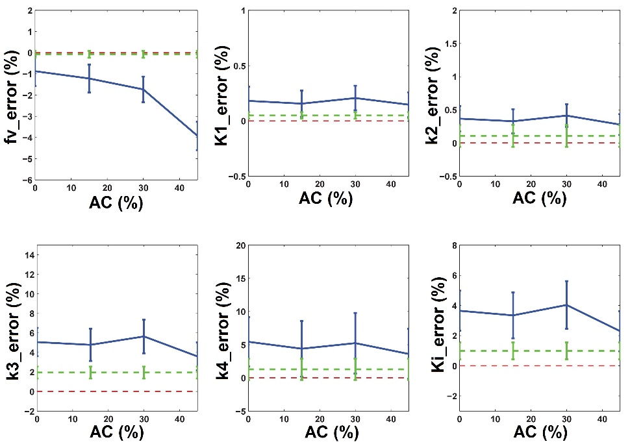
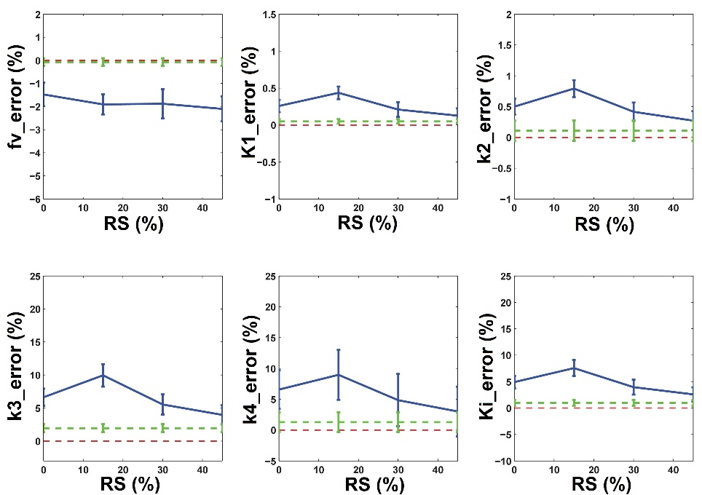
K1 | k2 | k3 | k4
0,426 | 0,660 | 0,010 | 0,022
Simulation 2 (T2)
Effect of accidental scattering and random counts on kinetic parameters estimation for both simulated phantoms.
 | K1 | k2 | k3 | k4
T1 | 0,082 | 0,055 | 0,085 | 0,002
T2 | 0,426 | 0,660 | 0,010 | 0,022
Saturday, April 2nd 2016
MEDICON 2016 - Paphos, Cyprus
Accidental Scattering
Random Counts
Dept. of Information Engineering,
University of Pisa, Pisa, Italy
Michele Scipioni
The influence of noise in dynamic PET direct reconstruction
Notes:
This new slide is very similar to the previous one but it shows the results related to the second simulation. Again, you can check the true value of the parameter on the top of the slide. Here the percentage errors of K values seem to be generally lower than for tissue T1. A possible reason, that could explain also the less bias observed for the rate constants K1 and k2, can be that T2’s kinetic parameters are comparably higher than those of T1 and that the estimation method could be influenced by such a difference in magnitude. Here we can appreciate how the noise is quite the only reason that keep the results away from the true values (just look at how close are the green line, the noiseless condition, to the zero-error-red-line) and how the estimate of high valued parameters helps in controlling the effect of the noise on the result.

Slide 21
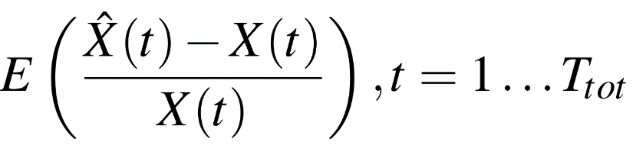
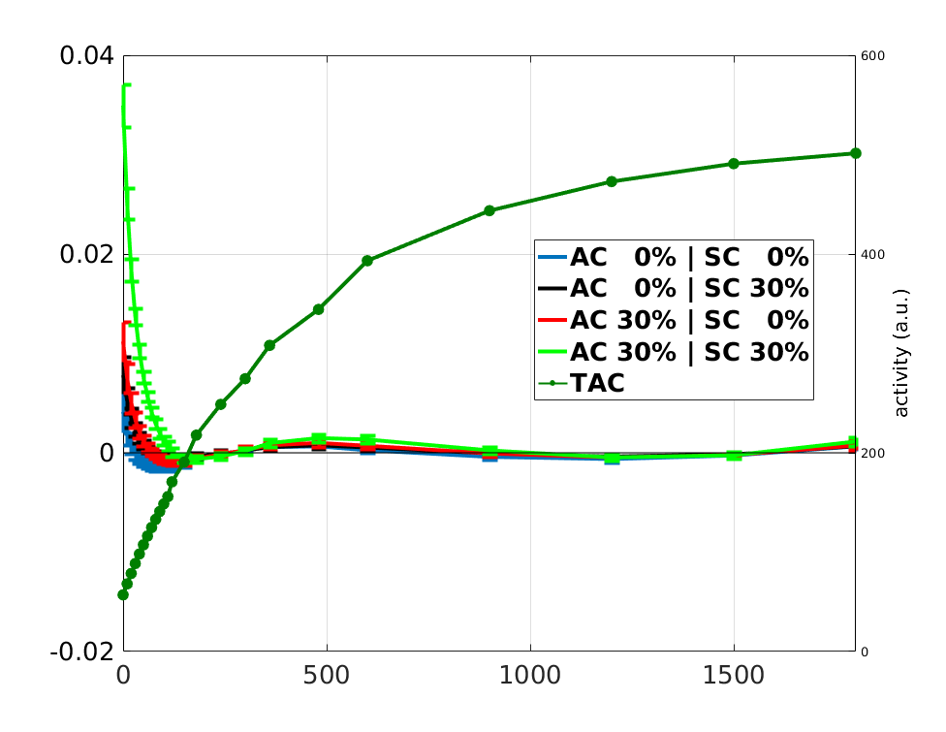
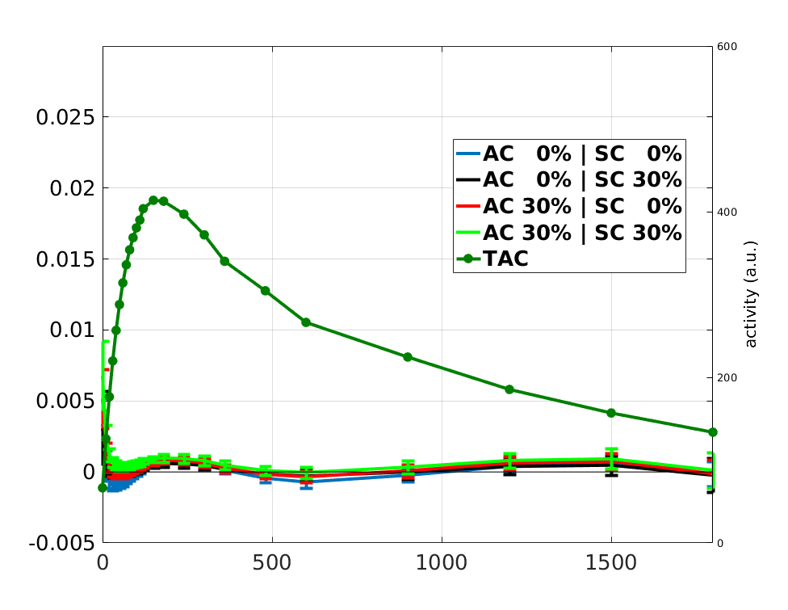
Dynamic images error
Saturday, April 2nd 2016
error (%)
error (%)
Activity (a.u.)
Activity (a.u.)
MEDICON 2016 - Paphos, Cyprus
Time (sec)
Time (sec)
Simulated tissue 1
Simulated tissue 2
Dept. of Information Engineering,
University of Pisa, Pisa, Italy
Michele Scipioni
The influence of noise in dynamic PET direct reconstruction
Notes:
The last result-related slide shows two particular graph. The emerald green line shows, in both graphs, the time activity curve of the corresponding simulated tissue. Other curve are error curves that describe, frame-wise the reconstruction error associated with the usage of a direct method on different noise conditions, created using this formula. This figure shows how the error, as well as depending, as expected, on noise, is higher in low emission frames (first time points for case 1 and first and last points for case 2), for any noise percentage values, as it can be seen taking into account the values of the superimposed TAC time series. However, in any case, it is important to note that the percentage error is always less than 1E-2.

Slide 22
Saturday, April 2nd 2016
Conclusions
MEDICON 2016 - Paphos, Cyprus
Dept. of Information Engineering,
University of Pisa, Pisa, Italy
Michele Scipioni
The influence of noise in dynamic PET direct reconstruction
Notes:
I think my time should be running out so let’s jump to the conclusions.

Slide 23
Summary and future development
In this work the behavior of a dynamic PET direct reconstruction algorithm on noisy data has been studied. We performed simulations in order to extract indexes that quantitatively describe the goodness of kinetic parameters estimation and dynamic images reconstruction.
Saturday, April 2nd 2016
The direct reconstruction algorithm tested grant good performance also in presence of noise on simulated data due to both accidental scattering and random counts.
MEDICON 2016 - Paphos, Cyprus
THE OBJECTIVE OF THE FUTURE WORK WILL BE TO DEFINE A NEW METHOD FOR ASSESSING THE ERROR IN PARAMETER ESTIMATION FROM THE KNOWLEDGE OF THE NOISE THAT AFFECTS MEASURED DATA.
Dept. of Information Engineering,
University of Pisa, Pisa, Italy
Michele Scipioni
The influence of noise in dynamic PET direct reconstruction
Notes:
In this work I studied the behavior of a dynamic PET direct reconstruction algorithm on noisy data, under a variety of different conditions. I performed simulations in order to extract indexes able to quantitatively describe the goodness of kinetic parameters estimation and dynamic images reconstruction. The next phase of the work will be to validate this error quantification algorithm on real phantom/clinical dynamic PET scans.
Then, since with direct algorithms we are dealing with raw sinogram data, we believe that the assessment of the final output of reconstruction and parameter estimation should be evaluated on those data so we are looking forward to develop a way to quantitatively evaluate the error in parameter estimation moving from the knowledge of the noise that affects measured raw data.

Slide 24
Saturday, April 2nd 2016
Thank you
for your attention!
MEDICON 2016 - Paphos, Cyprus
Dept. of Information Engineering,
University of Pisa, Pisa, Italy
Michele Scipioni
The influence of noise in dynamic PET direct reconstruction
Notes:
Thank you very much for your kind attention.

Slide 25
Appendix – Direct vs Indirect
Saturday, April 2nd 2016
MEDICON 2016 - Paphos, Cyprus
Dept. of Information Engineering,
University of Pisa, Pisa, Italy
Michele Scipioni
The influence of noise in dynamic PET direct reconstruction

Slide 26
Appendix - Optimization transfer
In order to estimate the updated parameter matrix K, we have to evaluate the following log-likelihood function:
Saturday, April 2nd 2016
measured sino
expected sino
penalization term
The proposed method finds the solution via an optimization transfer approach and dividing the update in 2 different steps:
MEDICON 2016 - Paphos, Cyprus
Frame-wise EM-like image update
Voxel-wise penalized likelihood fitting
Dept. of Information Engineering,
University of Pisa, Pisa, Italy
Michele Scipioni
The influence of noise in dynamic PET direct reconstruction

Slide 27
Appendix – EMIM16, Utercht 7-10 March 2016
Saturday, April 2nd 2016
MEDICON 2016 - Paphos, Cyprus
Dept. of Information Engineering,
University of Pisa, Pisa, Italy
Michele Scipioni
The influence of noise in dynamic PET direct reconstruction
Notes:
Thank you very much for your kind attention.

